Slide 1

2019 Airbnb in NYC
Gezheng Bai, Jiaxin Zhou, Yijie Yang, Minxing Sun

Slide 2
Background
The dataset contains detailed information (48895 observations and 16 columns) about Airbnb in New York in 2019, including their names, neighborhoods, room types, numbers of reviews and prices, etc.
Link; https://www.kaggle.com/datasets/dgomonov/new-york-city-airbnb-open-data

Slide 3
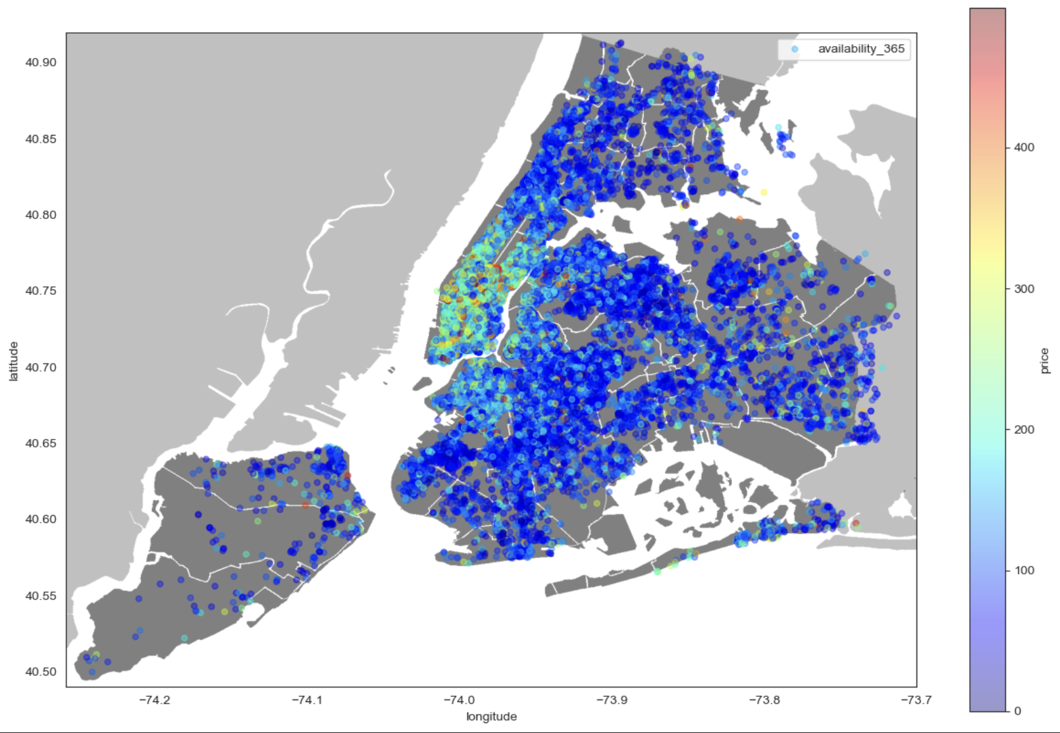
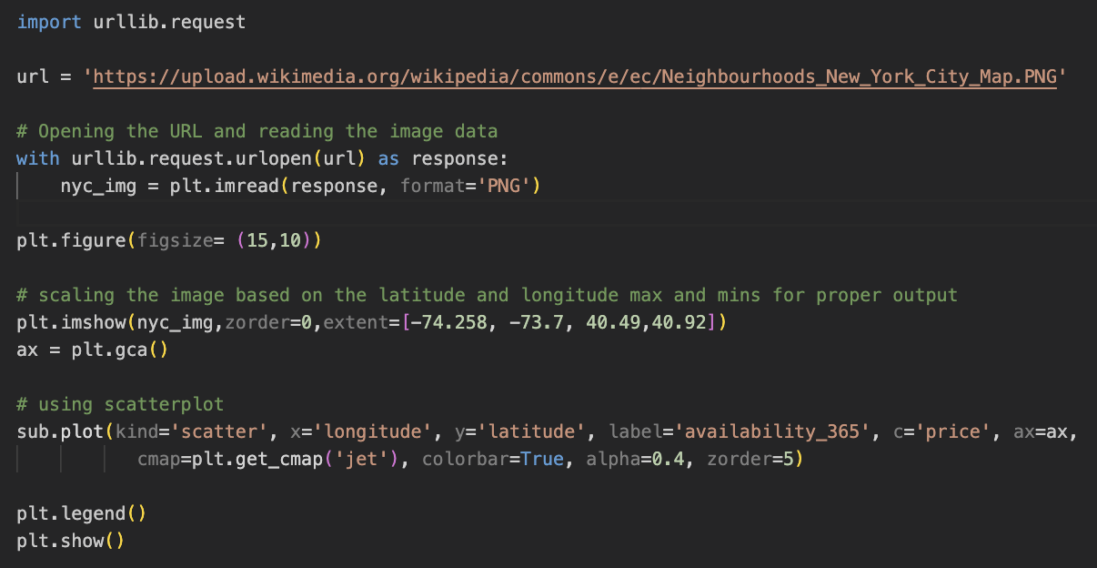
Data Exploration

Slide 4
Data Wrangling & Exploratory Data Anaylsis

Slide 5
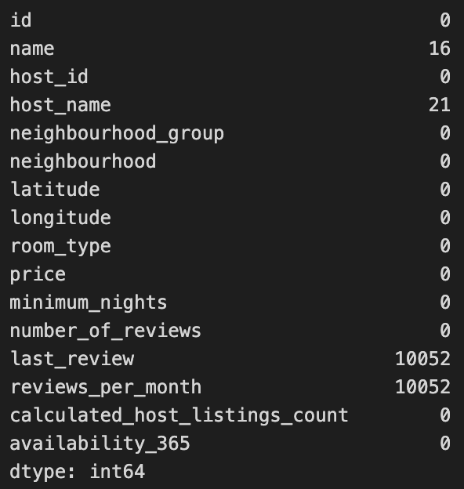
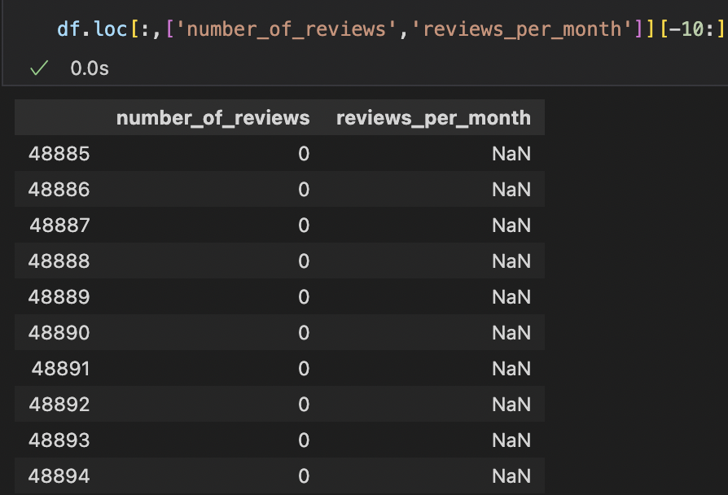
For the purpose of Wrangling the data, what is the most important is that we should deal with the NaN value in our dataset. Here, we can find that ‘number_of_reviews’ is consistent with ‘reviews_per_month’ .
the logic is that if we don’t have the total ‘number_of_revies’, then the ‘review_per_month’ also would be NaN, which is computed as ‘number_of_reivews’ / 12.
Thus, we prefer to let the ‘reviews_per_month’ with NaN value as 0. In this way, we will not change the probability distribution of our dataset. Besides, there also exist other ways such as replacing NaN with mean,mode,or median, or building a model to predict the missing value via relevant features.

Slide 6
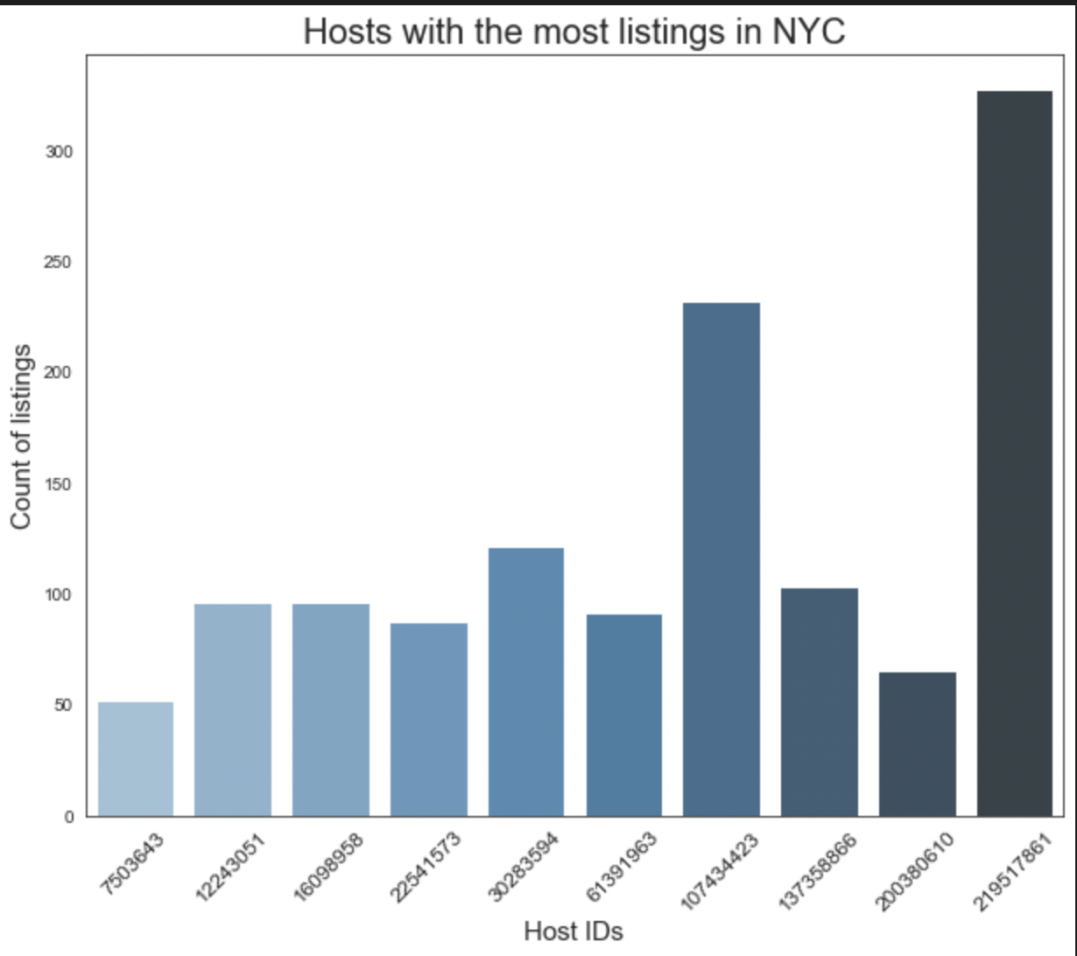
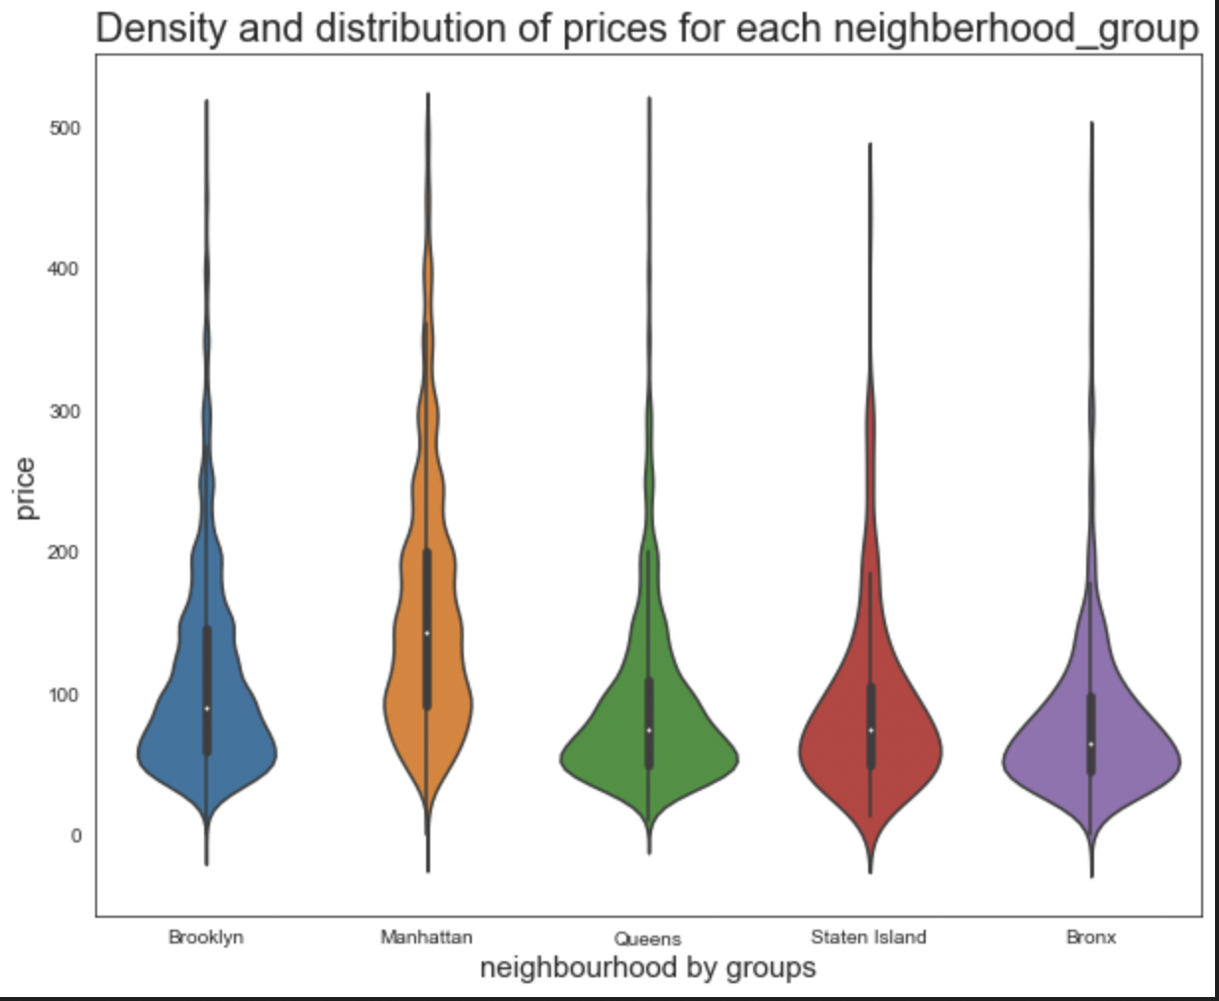
According to the left plot, we are able to find the Top 10 home hosts with the most renting rooms in the year 2019.
The right plot, we also provide the insight of the price distribution in the main Counties from Brooklyn to Bronx; Moreover, we can find the most prices in each area are lower than $200.

Slide 7
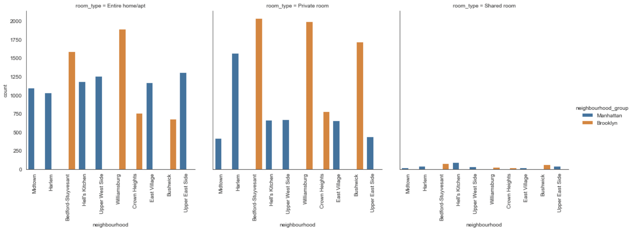
Above plots, we can find the room_type variates in different neighbourhoods, and from the first two plots, There are more Entire room/Private room being provided. We might guess that those two types are more prefered by the customers, however, this needs more data to prove.

Slide 8
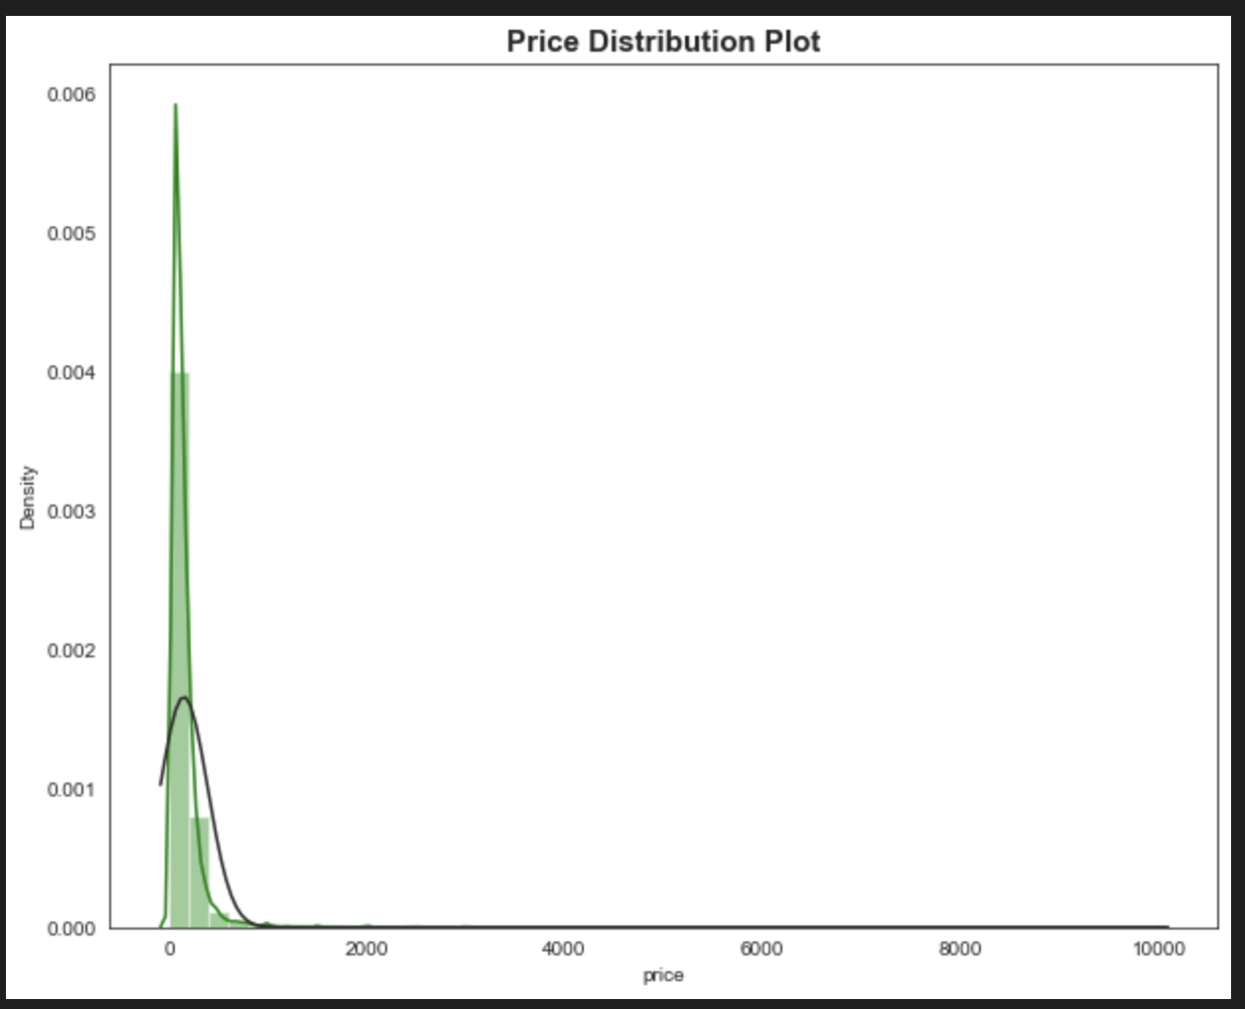
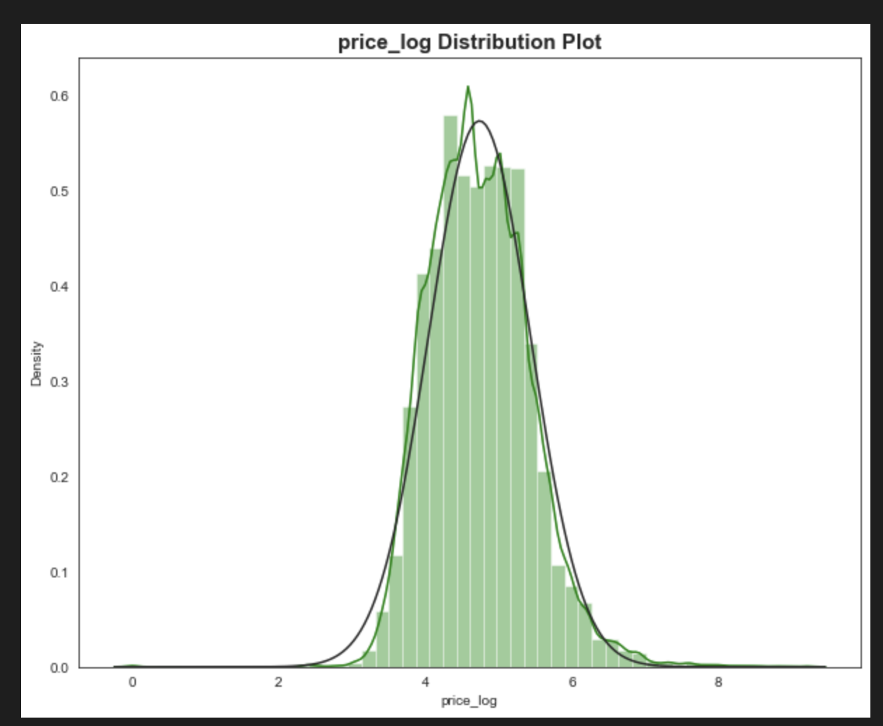
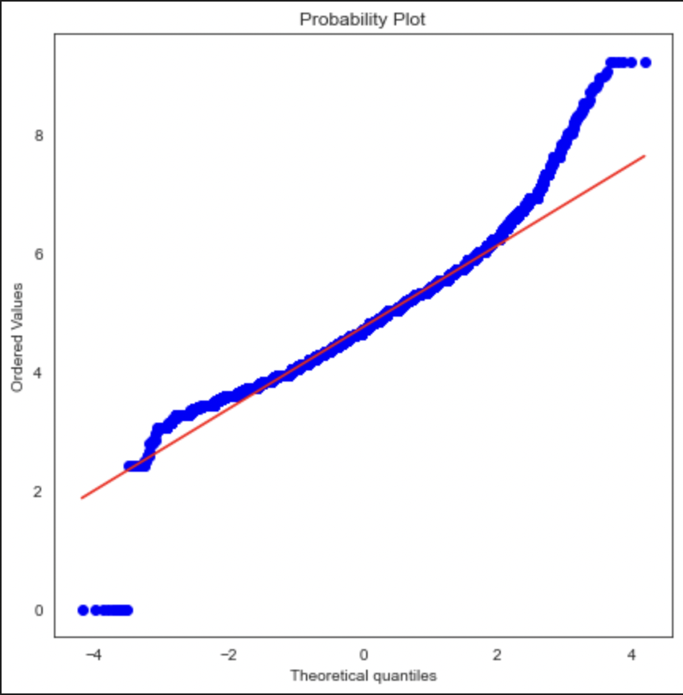
Besides, we also want the target features easier to fit our prediction model, so we find that the target feature ‘price’ is right-skewness distribution, and then we loglize the ‘price’ column, making it normalized, just as tht plots shown, it basically satisfies the normal distribution. Besides, in order to make classification, we also divide the target feature into a binary variable ‘High_prices’ and ‘Low_prices’.

Slide 9
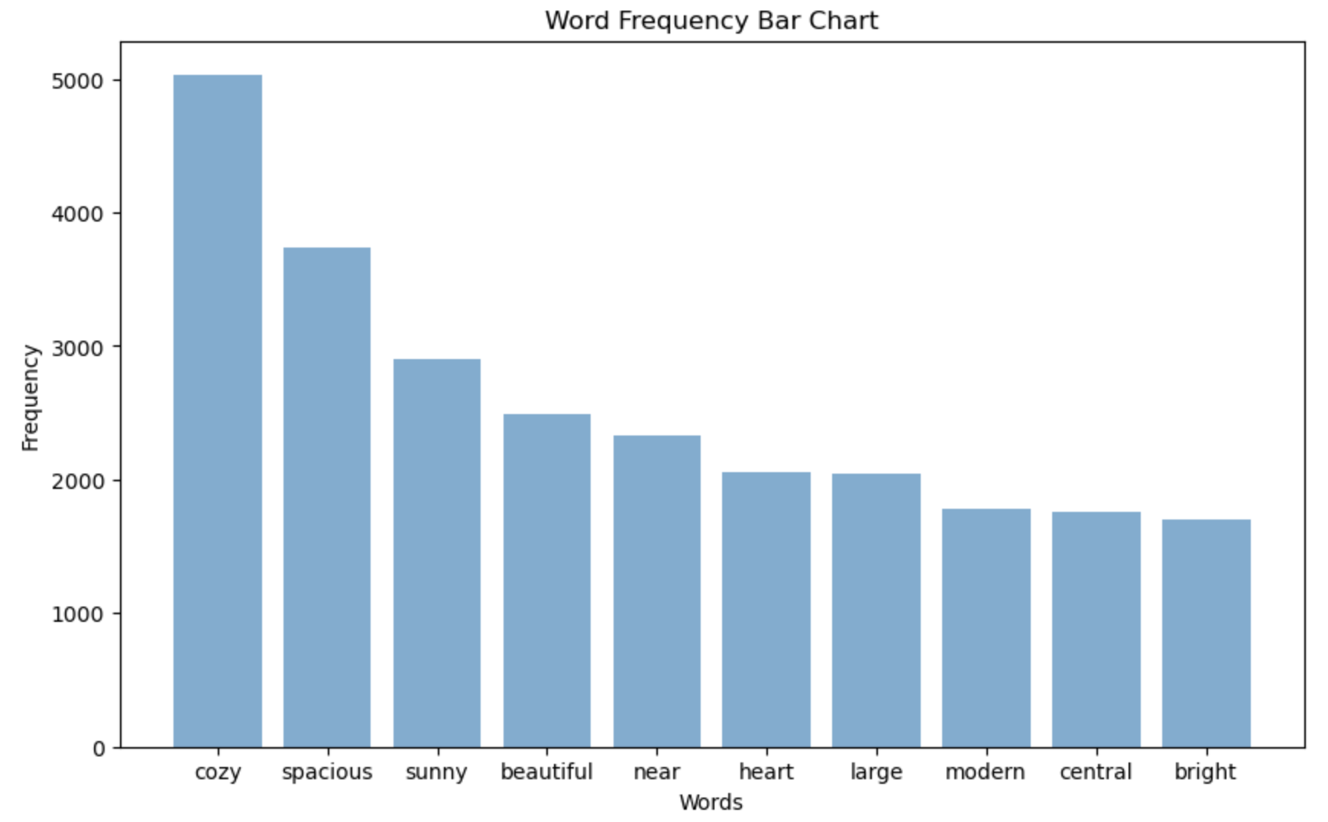
Tokenized names
Top key words in Airbnb housing names
nltk module
Removed stop words, punctuations, and meaningless words
Most frequent: room environment adj. & location

Slide 10
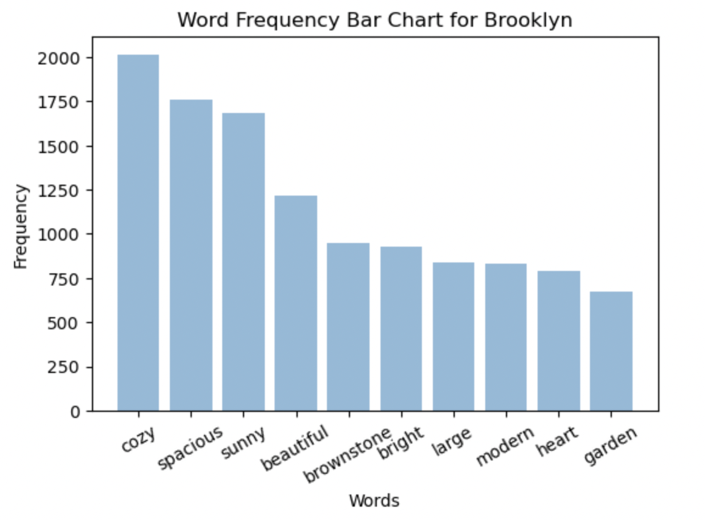
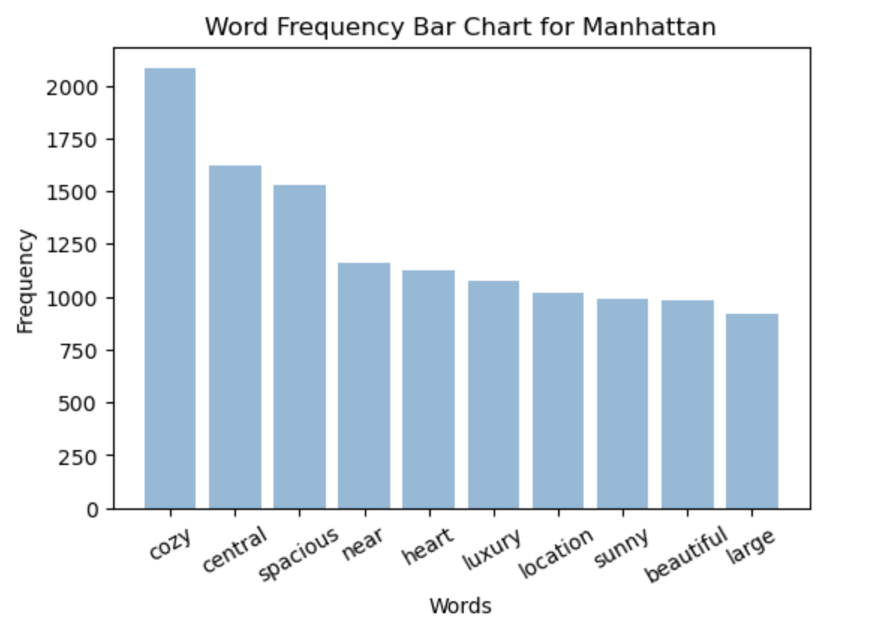
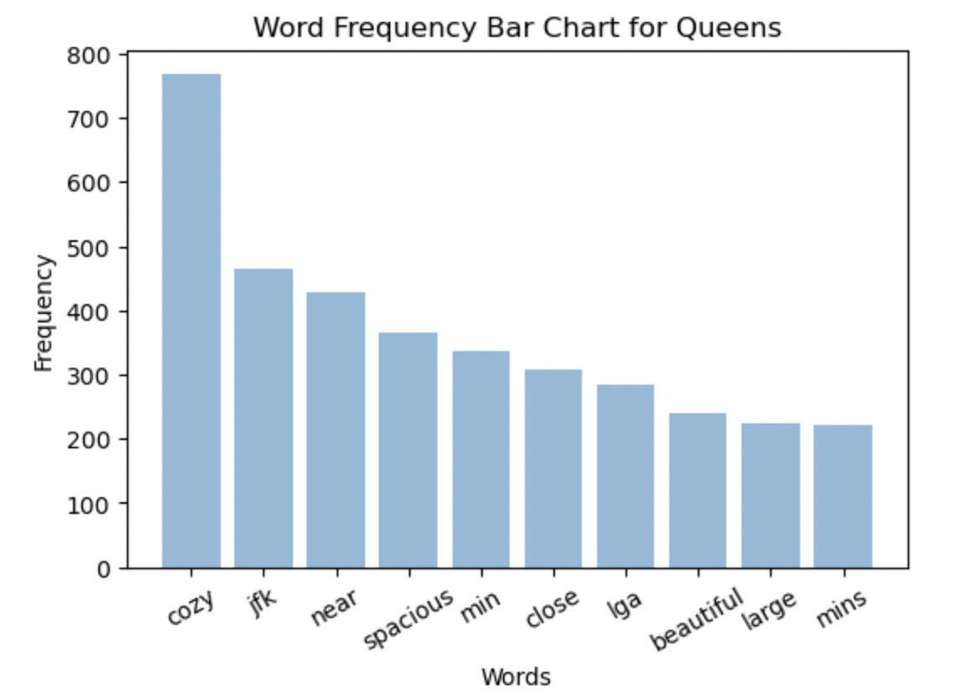
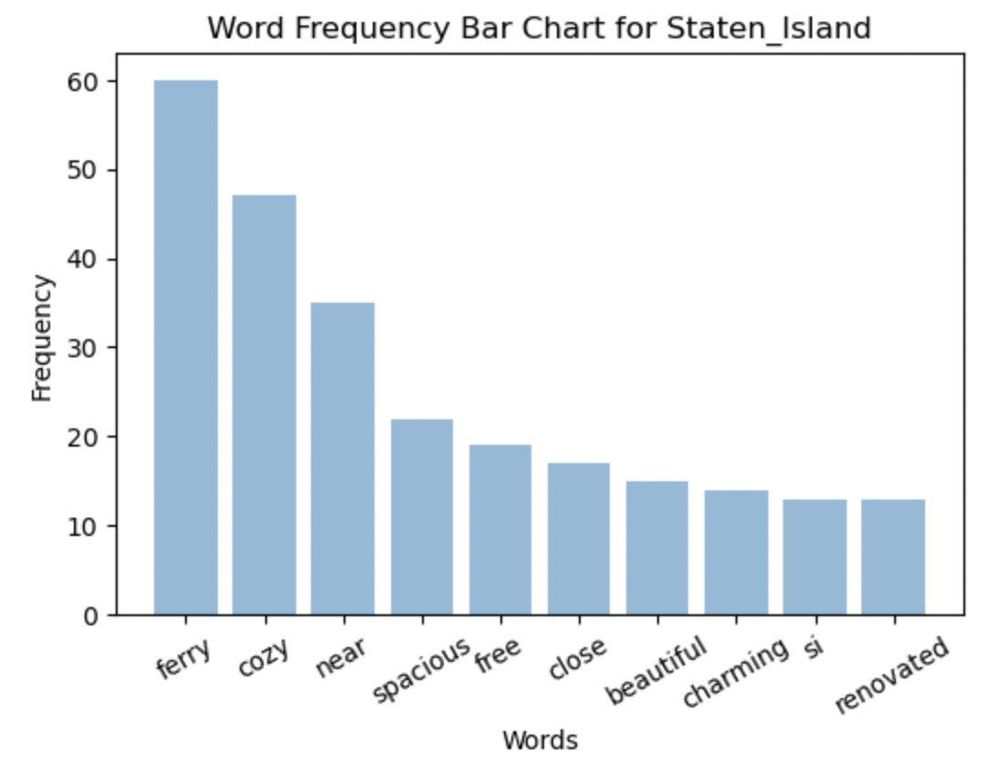
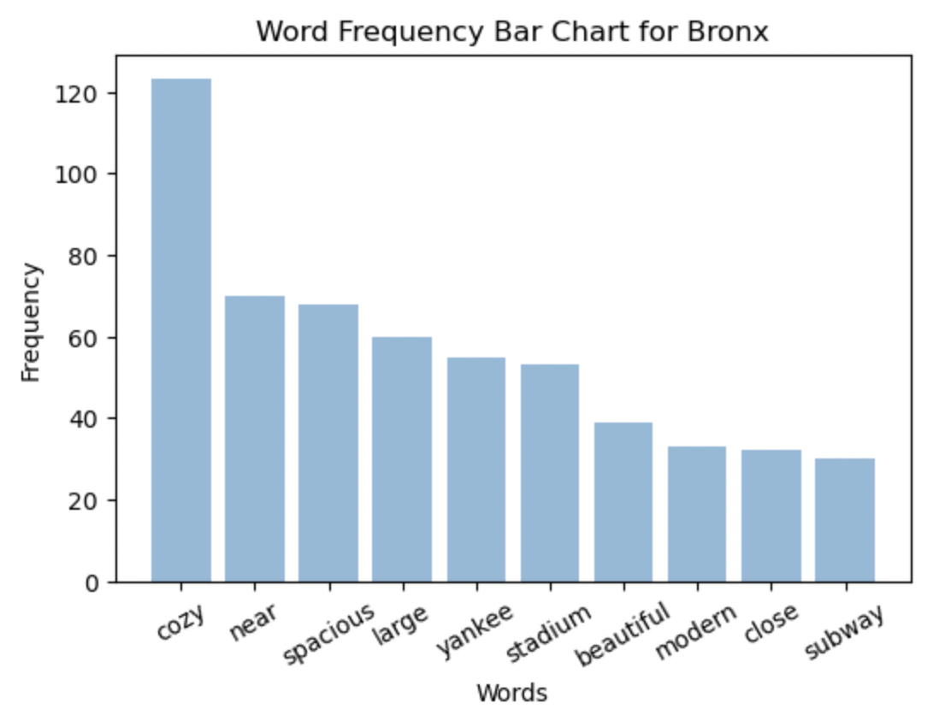
Top key words in each borough

Slide 11
Models
Predict Log Price
Linear Regression
Lasso Regression
Ridge Regression
Gradient Boosting Regression
Predict Price Classification
(high/low)
Linear Regression
Lasso Regression
Ridge Classifier
Gradient Boosting Classifier
Logistic Regression

Slide 12
Price Prediction
Prediction for Price Classification
Linear Regression:
Accuracy: 0.820,
f1: 0.825
Lasso Regression:
Accuracy: 0.549,
f1: 0.525
Ridge Classifier:
Accuracy: 0.820,
f1: 0.825
Gradient Boosting Classifier:
Accuracy: 0.829,
f1: 0.832
Logistic Regression:
Accuracy: 0.819,
f1: 0.824
Prediction for Log Price
Linear Regression:
MSE = 0.21,
R^2 = 0.41
Lasso Regression:
MSE = 0.46,
R^2 = 0.04
Ridge Regression:
MSE = 0.28,
R^2 = 0.41
Gradient Boosting Regression:
MSE = 0.21,
R^2 = 0.56
F1 score can be interpreted as a harmonic mean of the precision and recall, providing a balance between false positives and false negatives.

Slide 13
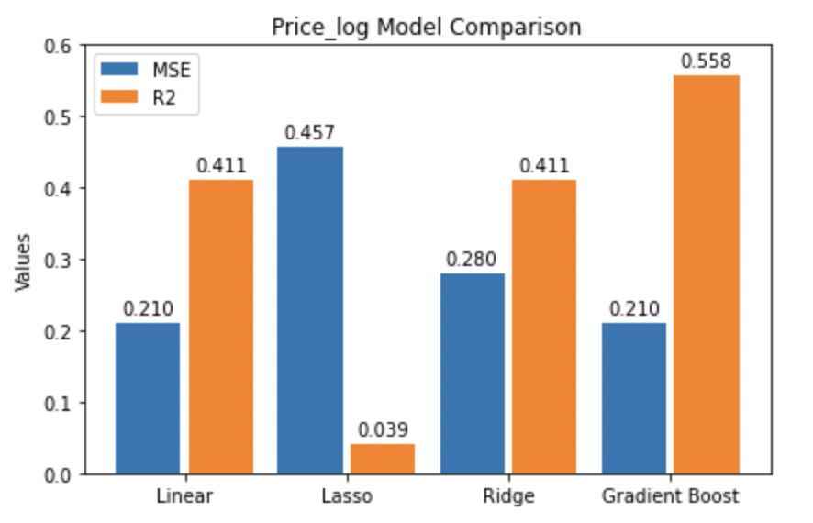
Log Price Models Histogram
R2 MSE
GBR: Explain 56% of the variance in the log price. Smallest prediction errors.
Performance

Slide 14
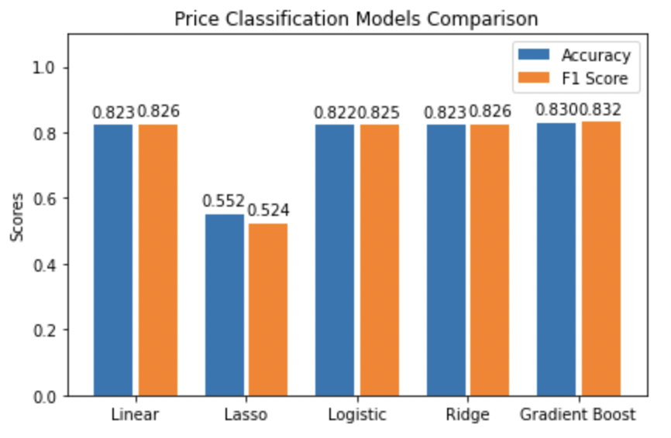
Classification Models Histogram
Accuracy F1
GBC: Best balance between precision and recall. Highest proportion of correct predictions.
L1 regularization: Add absolute value of coefficients multiplied by alpha to the loss function. Excessive shrinkage of the coefficients
underfitted.
Performance

Slide 15
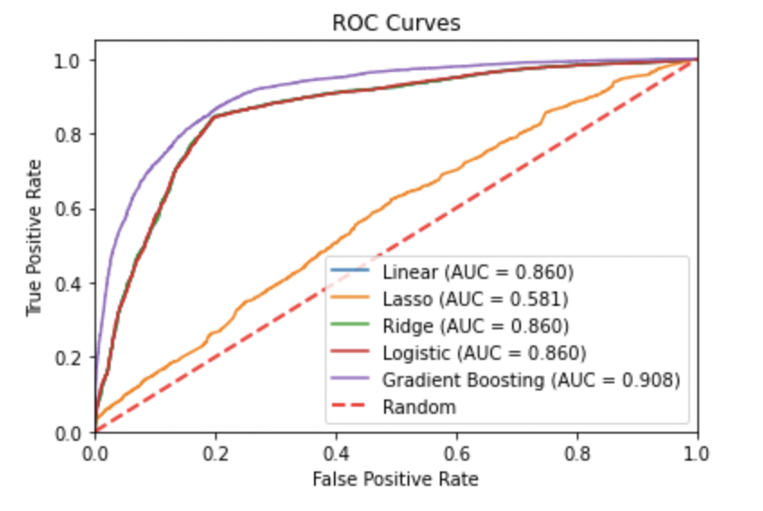
ROC curves
Methods Selection
Linear & Lasso: predict()
Ridge: decision_function() (need the signed distance to the decision boundary for computing the ROC curve)
Logistic: predict_proba() (probabilistic classifier and provide class probabilities)
Gradient Boost: predict_proba()
AUC 1 performance

Slide 16
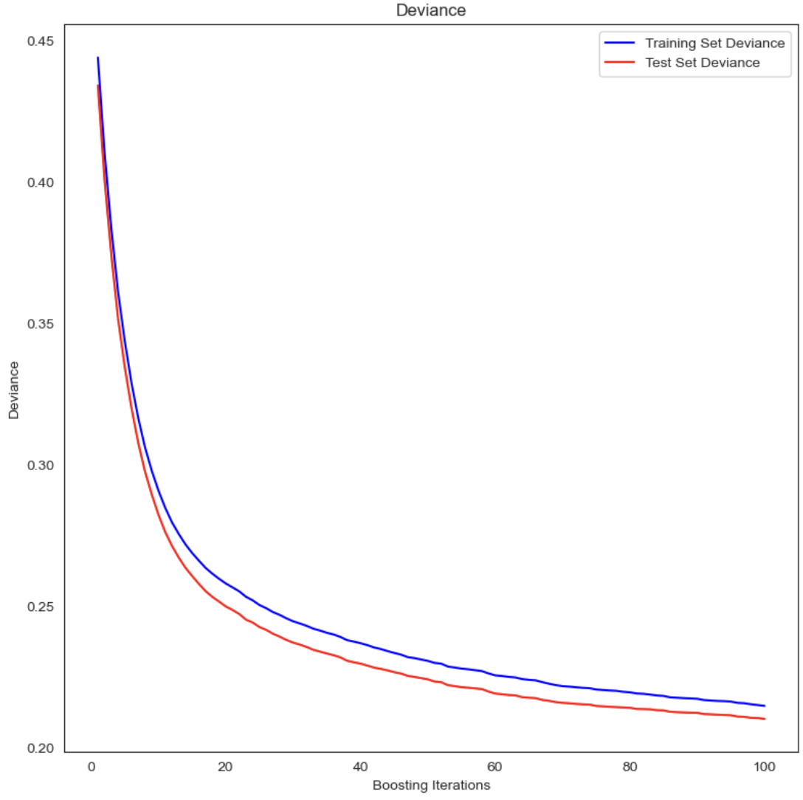
Best Model
the plot represents the training and test deviance (loss).
Winner: Gradient Boosting Regression/Classifier

Slide 17
Conclusion & Limitation & Interest
Manhattan has the highest Airbnb price, more specifically, houses in midtown and downtown are more expensive than other areas.
By tokenizing Airbnb names and finding the most frequent words, we provide a direct view of the keyword’s attraction for customer from house houlders’ perspective. In this case, we may tend to recommend house holder add more similar words like cozy, however, this need further validation.
The gradient boosting method has the best performance in both log_price prediction and price(low, high) classification, which minimized the overall prediction error.
When building the model we realized that it is not enough to only look at the accuracy and F1 score, the ROC and AUC provide a more valuable comparison between the models.
There is no rating score for review of renting, this lead us to a delima in popularity examination. Since the review frequency can not fully represent the satisfaction of customer. Thus, we can not give useful recommendation for renting to customers.
Even though we set the missing value in number_of_reviews to 0, it may still cuase imprecise conclusion for predicting model when number_of_reviews is our interested factor.
If we have more time, We are interested in doing more classification analysis, such as room type, since we found that the room type is highly correlated with the price in correlation matrix.

Slide 18
Thank you!
Github Code https://github.com/wowNorth0516/5243project/blob/main/5243Project.ipynb

